Slide 1
Poor man’s introduction to Python

Slide 2
Outline
Python Overview
Python Language Basics
Application to simple problems

Slide 3
Outline
Python
Easy to learn & use
Ubiquitous, Great for quick prototyping
Supports various programming styles
Procedural, Functional etc
Dynamically typed; interpretive language
A variable can be assigned to any data type
Strongly typed
Once assigned, it remains as that type
Documentation: https://docs.python.org

Slide 4
Outline
Python Basics – Program Organization
Indentations matter
Code block boundaries (e.g. for loop, while loop, if-else block, function block, etc.)
Modularization
A module in python: file containing a set of functions you want to include in your application.
Enables code reuse, importing functionality from other code
Packages
Modules can be combined to make packages
Packages => Module A => Module B => Module C
Can import entire package or specific module from a package

Slide 5
Outline
Python Basics – Built-in Datatypes
Basic Types
int, float, long, complex, boolean
Strings
Collections
List
Collection of objects (int, floats, any python object)
Tuple
Like lists, but unmutable
Dictionary
Key:Value pairs
Everything is an object
Will have its own methods to manipulate it

Slide 6
Outline
It’s now time to fire up Jupyter
[Expert Python coders can operate from the terminal]

Slide 7
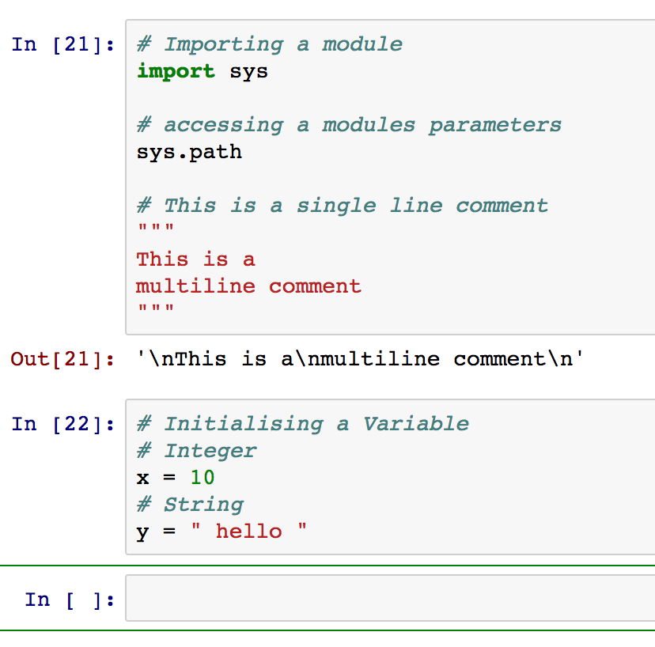
Outline
Python Basics – Example (1)

Slide 8
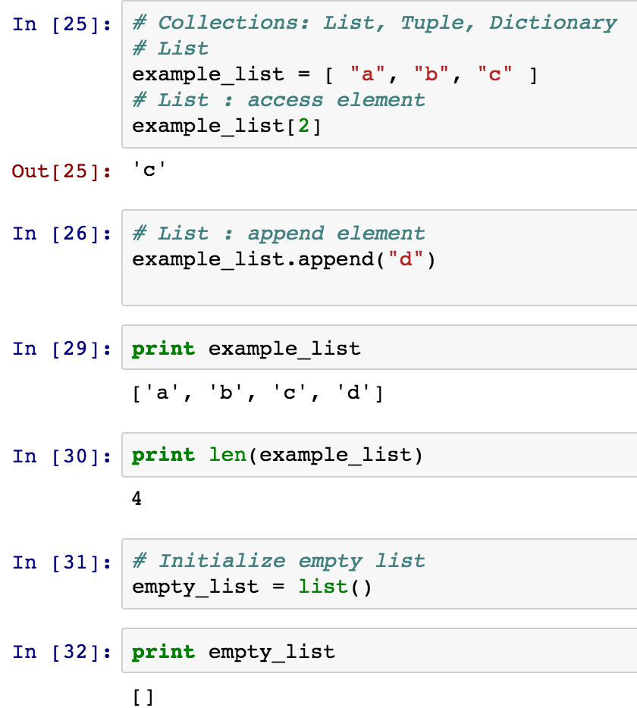
Outline
Python Basics – Example (2)
( )
( )
( )

Slide 9
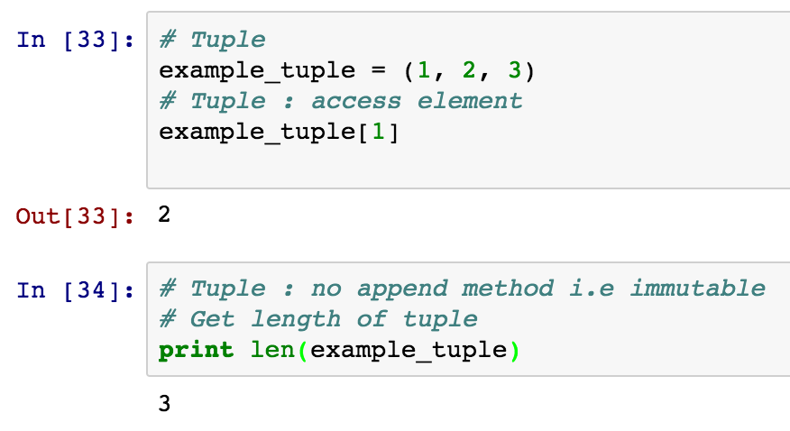
Outline
Python Basics – Example (3)
( )

Slide 10
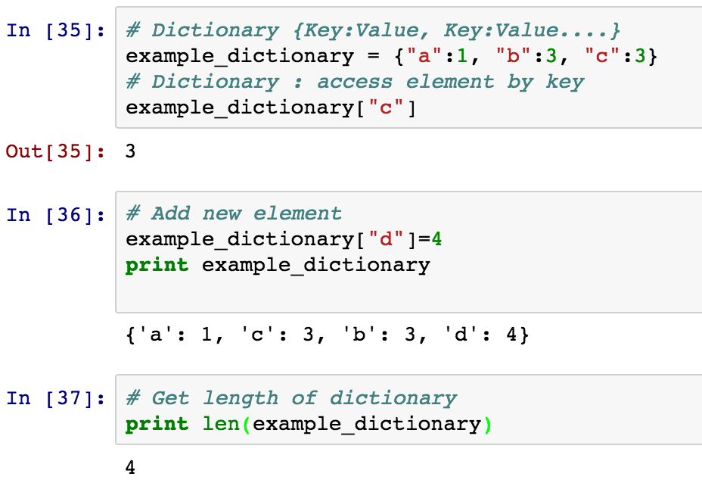
Outline
Python Basics – Example (4)
( )
( )

Slide 11
Outline
Python Basics – Control Flow (1)
while loop:
while expression/boolean:
statements ….
….
for loop:
for x in ‘some iterable collection’:
statements …
break
Terminates loop
continue
Next iteration of loop
pass

Slide 12
Outline
Python Basics – Control Flow (2)
if elif else
If condition:
statements….
elif:
statements
else:
statements….
functions
def function_name(arguments):
statements …

Slide 13
Outline
Python Basics – Control Flow Example (1)
recreate the list example_list
( )
( )
( )

Slide 14
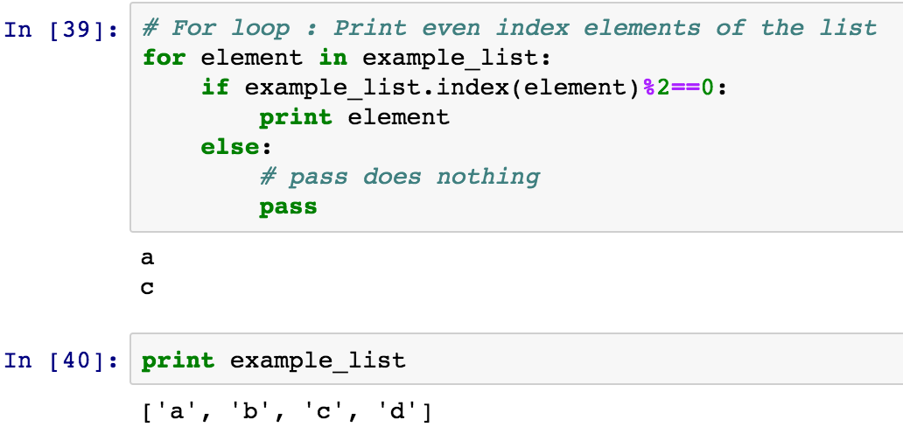
Outline
Python Basics – Control Flow Example (2)
( )
( )

Slide 15
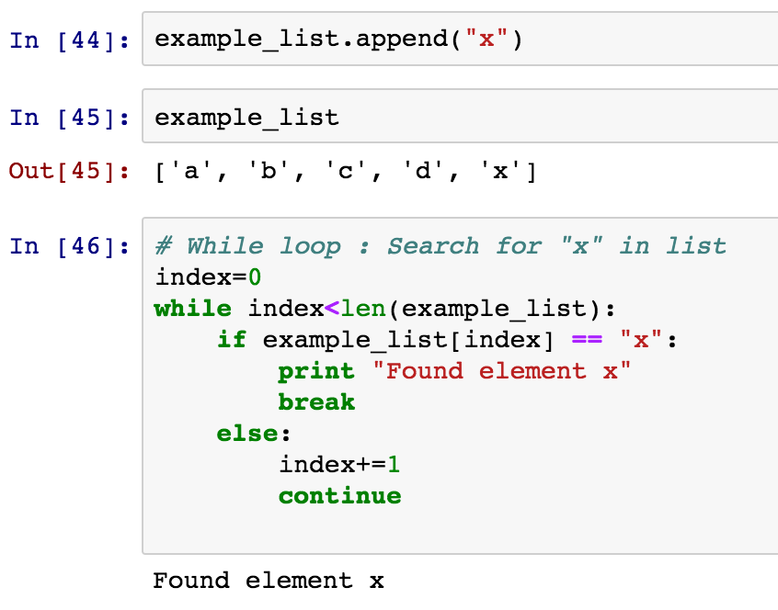
Outline
Python Basics – Control Flow Example (3)
( )

Slide 16
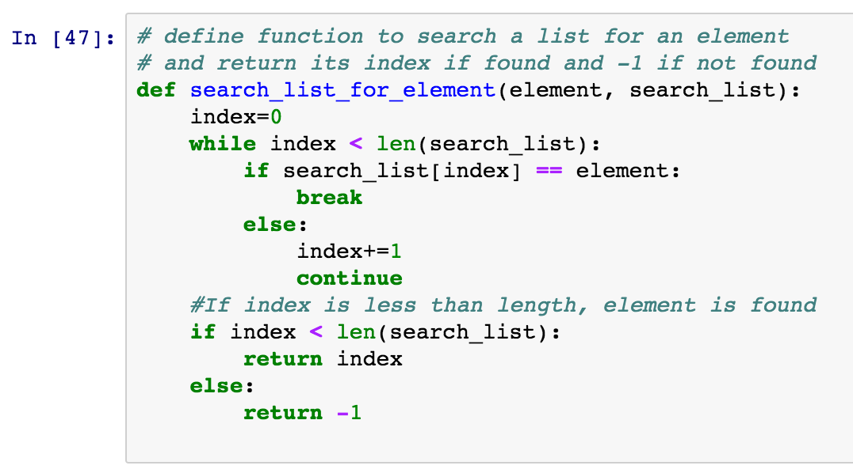
Outline
Python Basics – Control Flow Example (4)

Slide 17
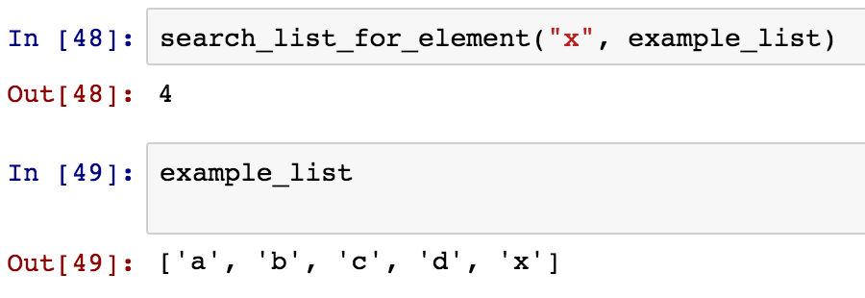
Outline
Python Basics – Control Flow Example (5)

Slide 18
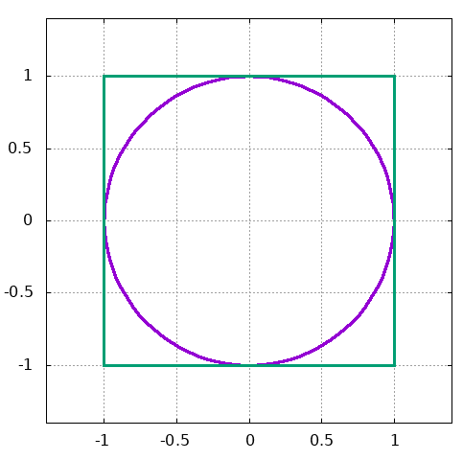
Outline
Determination of pi using Monte Carlo
If a dart thrown has an equal probability of landing anywhere inside the green square box:
$$\frac{Area of cirle of radius 1}{Area of square of side 2}=\frac{N_{C}}{N}$$
where $N_{C}$ is the number darts which land inside the circle and $N$ is the total number which land in the square.
This implies that
$$\frac{π{(1)}^{2}}{4}=\frac{N_{C}}{N}⇒π=\frac{4N_{C}}{N}$$

Slide 19
Outline
Determination of pi using Monte Carlo

Slide 20
Determination of area under a curve Monte Carlo

Slide 21
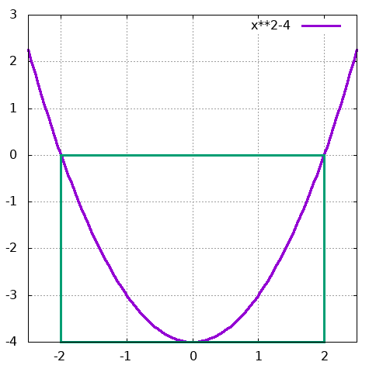
Outline
Determination of area under a curve Monte Carlo
If a dart thrown has an equal probability of landing anywhere inside the green square box:
$$\frac{A}{Area of square of side 4}=\frac{N_{C}}{N}$$
where A is the area between curves and the x-axis, $N_{C}$ is the number darts which land inside the circle and $N$ is the total number which land in the square.
This implies that
$$\frac{A}{16}=\frac{N_{C}}{N}⇒A=\frac{16N_{C}}{N}$$

Slide 22
Outline
Determination of area under a curve Monte Carlo

Slide 23
Outline
Rosenbrock Function Minimization using Steepest Descent
Function minimization
Rosenbrock function: $E\left(x_{1},x_{2}\right)=(1−{x_{1})}^{2}+100({x_{2}−{x_{1}}^{2})}^{2}$
The partial derivatives are:
$$\frac{∂E}{{∂x}_{1}}=−2\left(1−x_{1}\right)−400x_{1}(x_{2}−{x_{1}}^{2})$$
$$\frac{∂E}{{∂x}_{2}}=200 (x_{2}−{x_{1}}^{2})$$
Exact results of minimization: $\left(x_{1},x_{2}\right)=(1,1)$ $E_{min}=0$

Slide 24
Outline
Rosenbrock function Minimization using Steepest Descent

